Slide 1
CHAPTER - III
Memory Management(MM)

Slide 2
What is a memory?
Memory is a large array of words or bytes, each with its own address in computer system.
A program resides on a disk as a binary executable file.
The program must be brought into memory and placed within a process for it to be executed depending on the memory management in use.
The process may be moved between disk and memory during its execution.
The collection of processes on the disk that are waiting to be brought into memory for execution forms the input queue; i.e. selected one of the process in the input queue and to load that process into memory.

Slide 3
Memory management
Memory management is the functionality of an operating system which handles or manages primary memory.
Memory management keeps track of each and every memory location either it is allocated to some process or it is free.
It checks how much memory is to be allocated to processes and decides which process will get memory at what time.
It tracks whenever some memory gets freed or unallocated and correspondingly it updates the status.
Memory management provides protection by using two registers, a base register and a limit register.
A pair of registers define the logical address space.

Slide 4
Continued…
CPU must check every memory access generated in user mode to be sure it is between base and limit for that user.
The base register holds the smallest legal physical memory address and the limit register specifies the size of the range.
For example, if the base register holds 300000 and the limit register is 1209000, then the program can legally access all addresses from 300000 through 411999.

Slide 5
Base and Limit Registers

Slide 6
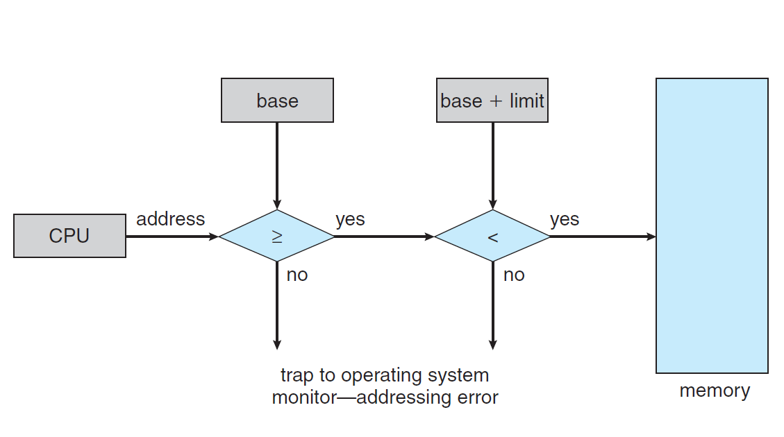
Hardware Address Protection

Slide 7
Logical versus Physical Address Space
An address generated by the CPU is a logical address whereas address actually available on memory unit is a physical address.
Logical address is also known as Virtual address which are independent of location in physical memory data lives.
The set of all physical addresses corresponding to these logical addresses is referred to as a physical address space.
Virtual and physical addresses are the same in compile-time and load-time address-binding schemes; differ in execution-time address-binding scheme.
The set of all logical addresses generated by a program is referred to as a logical address space.
Logical/virtual addresses are translated by hardware into physical addresses (with some setup from OS).
OS determines location in physical memory

Slide 8
Three types of addresses are used in a program before and after memory is allocated:-
1. Symbolic addresses
The addresses used in a source program.
The variable names, symbolic constants, and instruction labels are the basic elements of the symbolic address space.
2. Relative addresses:
Relative address means an address specified by indicating its distance from another address, called the base address
For example, a relative address might be B+15, B being the base address and 15 the distance (called the offset).
A compiler converts symbolic addresses into relative addresses(object code).
3. Physical addresses:
The final address generated when a program is loaded and ready to execute in physical memory;
the loader generates these addresses.

Slide 9
Instructions and data to memory addresses can be done in following ways.
Compile time -- When it is known at compile time where the process will reside, compile time binding is used to generate the absolute code.
Load time -- When it is not known at compile time where the process will reside in memory, then the compiler generates re-locatable code.
Execution time -- If the process can be moved during its execution from one memory segment to another, then binding must be delayed to be done at run time.

Slide 10
Binding
The memory manager allocates a block of memory locations to the absolute program and the loader moves the program into the allocated memory block.
At load time, the absolute program is loaded starting at a particular physical address in main memory.
The re locatable addresses are mapped to physical addresses; each logical address is bound to a physical address in memory.

Slide 11
The absolute program becomes an executable program right after its logical addresses are translated (mapped) to the corresponding physical addresses.
The general address translation procedure is called ADDRESS BINDING.
1. EARLY OR STATIC BINDING.
If the mapping (or conversion) of logical addresses to physical addresses is carried out before execution time, it is known as early or static binding.
2. LATE OR DYNAMIC BINDING
A more advanced binding technique delays the mapping from logical to physical addresses until the process starts to execute.
This second type of binding is called late or dynamic binding.

Slide 12
Loading
In dynamic loading, a routine of a program is not loaded until it is called by the program.
All routines are kept on disk in a re-locatable load format.
The main program is loaded into memory and is executed.
Other routines methods or modules are loaded on request.
Dynamic loading makes better memory space utilization and unused routines are never loaded.

Slide 13
Linking
Linking is the process of collecting and combining various modules of code and data into a executable file that can be loaded into memory and executed.
Operating system can link system level libraries to a program.
When it combines the libraries at load time, the linking is called static linking and
when this linking is done at the time of execution, it is called as dynamic linking.
In static linking, libraries linked at compile time, so program code size becomes bigger whereas in dynamic linking libraries linked at execution time so program code size remains smaller.
Virtual and physical addresses are the same in compile-time and load-time address-binding schemes; differ in execution-time address-binding scheme.

Slide 14
Memory management unit (MMU)
The run-time mapping from virtual to physical address is done by the memory management unit (MMU) which is a hardware device.
MMU uses following mechanism to convert virtual address to physical address.
The base register is called a relocation register.
The value in the relocation register is added to every address generated by a user process at the time it is sent to memory.
The user program deals with logical addresses; it never sees the real physical addresses.
– Execution-time binding occurs when reference is made to location in memory
– Logical address bound to physical addresses.

Slide 15
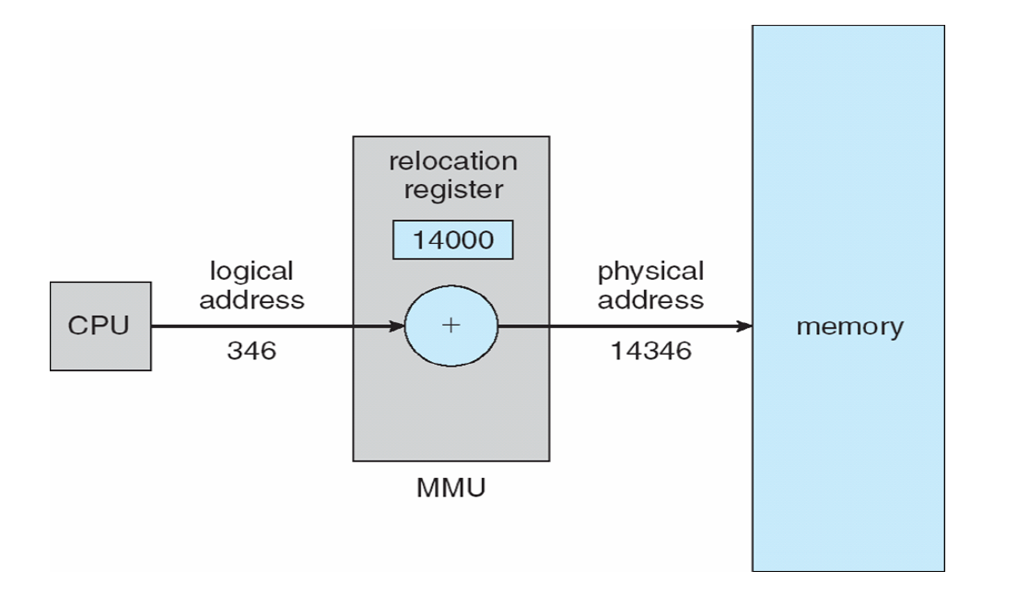
MMU as a relocation register

Slide 16
Swapping
Swapping is a mechanism in which a process can be swapped temporarily out of main memory to a backing store , and then brought back into memory for continued execution.
Backing store is a usually a hard disk drive or any other secondary storage which fast in access and large enough to accommodate copies of all memory images for all users.
It must be capable of providing direct access to these memory images.
Major time consuming part of swapping is transfer time.
Total transfer time is directly proportional to the amount of memory swapped.
Let us assume that the user process is of size 100KB and the backing store is a standard hard disk with transfer rate of 1 MB per second.
The actual transfer of the 100K process to or from memory will take 100KB / 1000KB per second = 1/10 second = 100 milliseconds.

Slide 17
Cont…
Assume a multiprogramming environment with a round robin CPU-scheduling algorithm.
When a quantum expires, the memory manager will start to swap out the process that just finished, and to swap in another process to the memory space that has been freed.
When each process finishes its quantum, it will be swapped with another process.
Idle processes are mostly stored on disk, so they do not take up any memory when they are not running.

Slide 18
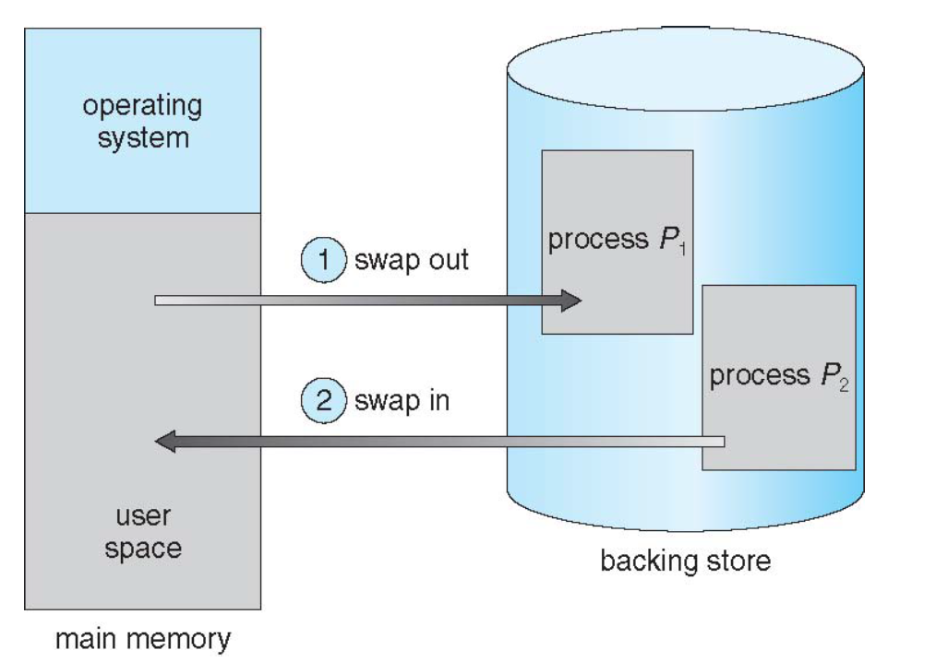
Schematic View of Swapping

Slide 19
Context Switch Time including Swapping
If next processes to be put on CPU is not in memory,– need to swap out a process and swap in target process
Context switch time can then be very high e.g 100MB process swapping to hard disk with transfer rate of 50MB/sec– Swap out time of 2000 ms
– Plus swap in of same sized process
– Total context switch swapping component time of 4000ms (4 seconds)

Slide 20
Memory Allocation (Contiguous Allocation)
The main memory must accommodate both the operating system and the various user processes.
The memory is usually divided into two partitions, one for the resident operating system, and one for the user processes.
Those Main memory has two partitions :-
Low Memory -- Operating system resides in this memory.
High Memory --User processes then held in high memory.

Slide 21
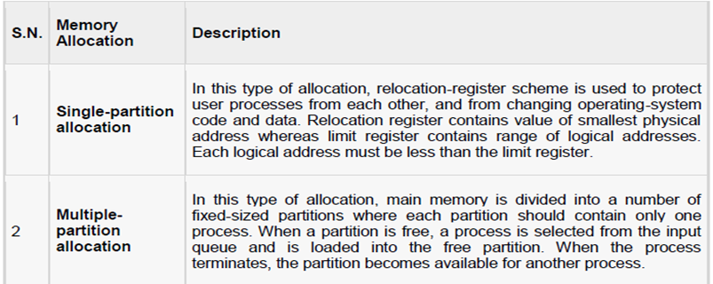
OS uses the following memory allocation mechanism.

Slide 22
Memory allocation is done using Round-Robin Sequence.
Contiguous blocks of available (unallocated) memory are called holes.
When a process arrives and needs memory, we search this set for a hole that is large enough for this process.
If the hole is too large, it is split into two: One part is allocated to the arriving process; the other is returned to the set of holes.
When a process terminates, it releases its block of memory, which is then placed back in the set of holes. If the new hole is adjacent to other holes, we merge these adjacent holes to form one larger hole.
This procedure is a particular instance of the general dynamic storage-allocation problem, which is how to satisfy a request of size n from a list of free holes.

Slide 23
There are many solutions to this problem.
The set of holes is searched to determine which hole is best to allocate, first-fit, best-fit, and worst-fit are the most common strategies used to select a free hole from the set of available holes.
First-fit:
Allocate the first hole that is big enough.
Searching can start either at the beginning of the set of holes or where the previous first-fit search ended.
We can stop searching as soon as we find a free hole that is large enough.
Best-fit:
Allocate the smallest hole that is big enough.
We must search the entire list, unless the list is kept ordered by size.
This strategy-produces the smallest leftover hole.
Worst-fit:
Allocate the largest hole.
Again, we must search the entire list unless it is sorted by size.
This strategy produces the largest leftover hole which may be more useful than the smaller leftover hole from a best-t approach.
First-fit and best-fit better than worst-fit in terms of speed and storage utilization.

Slide 24
Fragmentation
As processes are loaded and removed from memory, the free memory space is broken into little pieces.
It happens after sometimes that processes cannot be allocated to memory blocks considering their small size and memory blocks remains unused.
This problem is known as Fragmentation.
Fragmentation cause waste of memory and a compaction technique can be used to create more free memory out of fragmented memory:

Slide 25
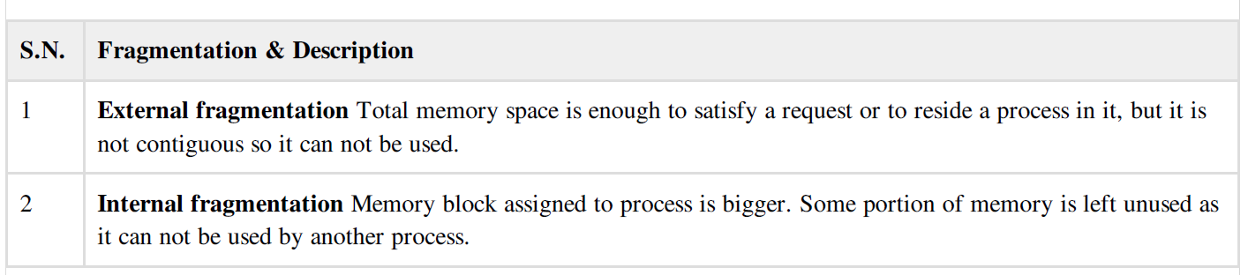
Fragmentation is of two types

Slide 26
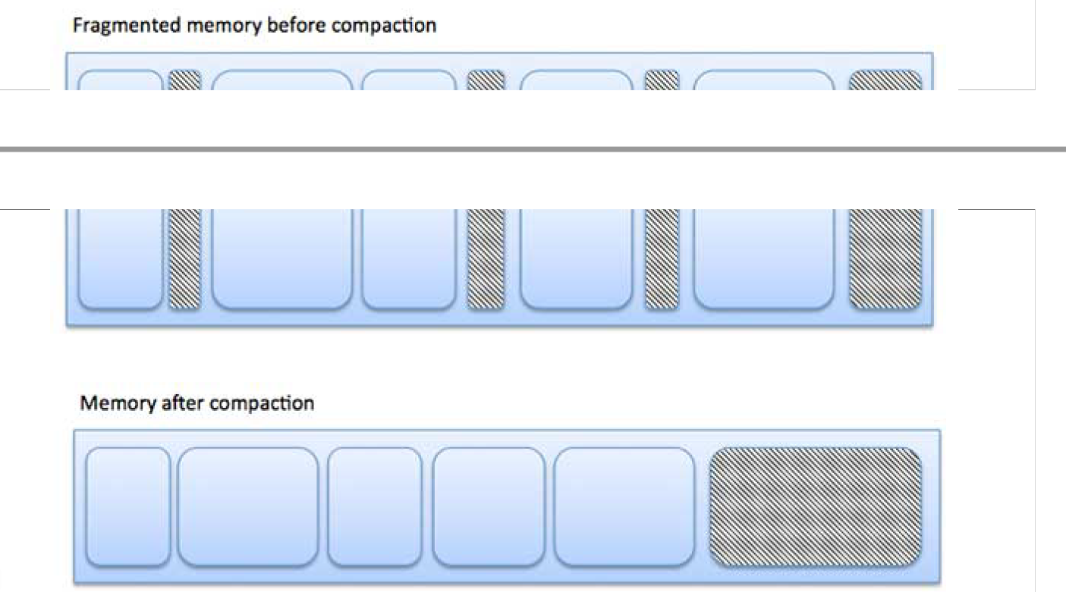
fragmentation cause waste of memory and a compaction technique can be used to create more free memory out of fragmented memory:

Slide 27
Paging
Paging is a memory management technique in which process address space is broken into blocks of the same size called pages (size is power of 2, between 512 bytes and 8192 bytes).
The size of the process is measured in the number of pages.
Similarly main memory is divided into small fixed-sized blocks of (physical) memory called frames
and the size of a frame is kept the same as that of a page to have optimum utilization of the main memory and to avoid external fragmentation.

Slide 28
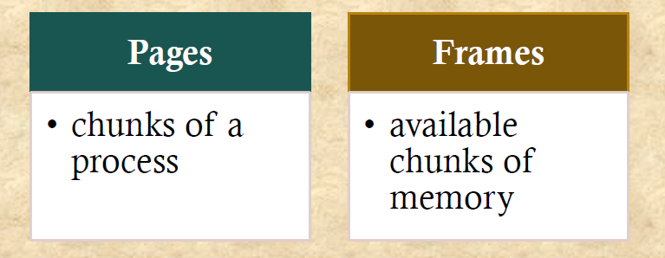
Cont…

Slide 29
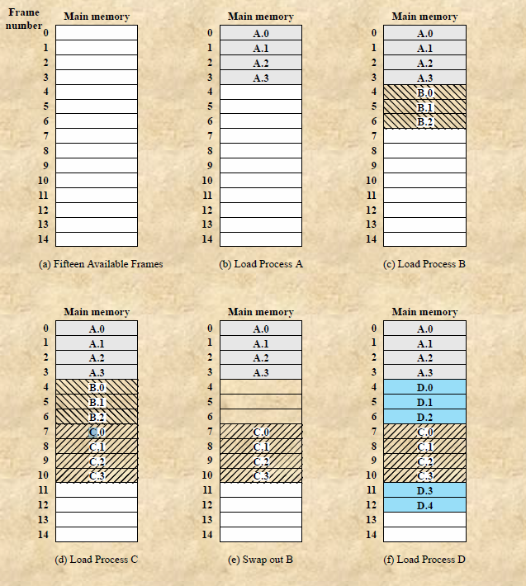
Assignment of Process Pages to Free Frames

Slide 30
Process Page Table
Maintained by operating system for each process
Contains the frame location for each page in the process
Processor must know how to access for the current process
Used by processor to produce a physical address

Slide 31
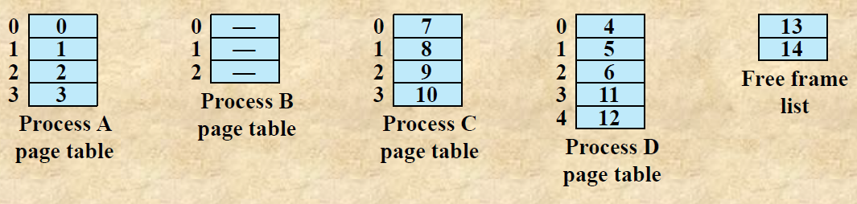
Cont…

Slide 32
Address Translation Scheme
Address generated by CPU is divided into:-
Page number (p) – used as an index into a page table and contains base address of each page in physical memory.
Page offset (d) – combined with base address to define the physical memory address that is sent to the memory.

Slide 33
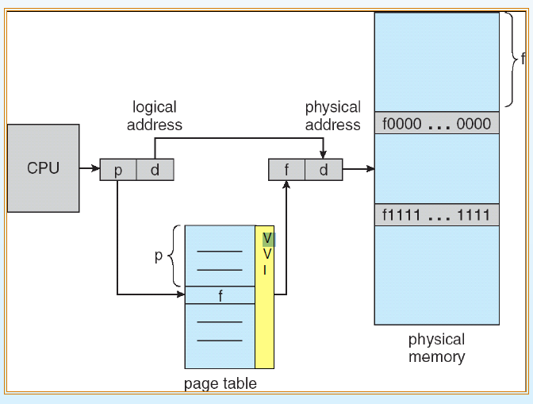
Address Translation Architecture!

Slide 34
Two-Level Paging Example
A logical address (on 32-bit machine ) is divided into:
a page number consisting of 20 bits"
a page offset consisting of 12 bits"
Since the page table is paged, the page number is further divided into:"
a 10-bit page number "
a 10-bit page offset“
Thus, a logical address is as follows:

Slide 35
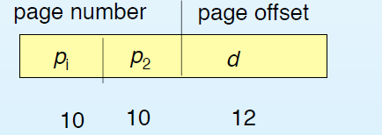
Cont…

Slide 36
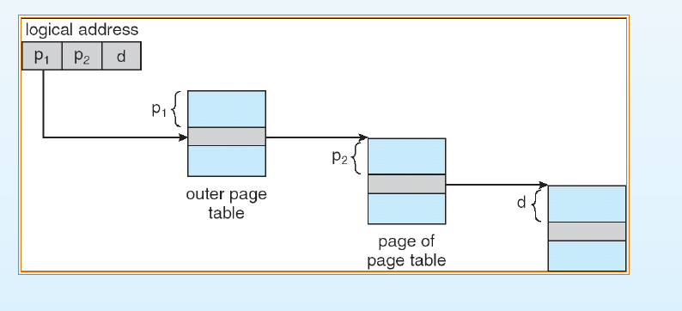
Address-translation scheme for a two-level 3 bit paging architecture
.
.
where pi is an index into the outer page table, and p2 is the displacement within the page of the outer page table.

Slide 37
Segmentation
Segmentation is a technique to break memory into logical pieces where each piece represents a group of related information.
For example, data segments or code segment for each process, data segment for operating system and so on. Segmentation can be implemented using or without using paging.
Segmentation eliminates internal fragmentation but, like dynamic partitioning, it suffers from external fragmentation.
Unlike paging, segment is having varying sizes and thus eliminates internal fragmentation. External fragmentation still exists but to lesser extent.

Slide 38
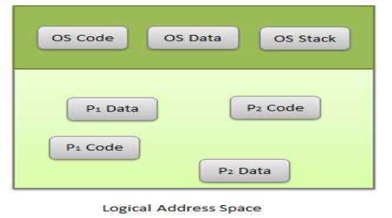
Cont…

Slide 39
Segments are variable-length modules of a program that correspond to logical units of the program; that is, segments represent the modular structure of how a program is organized.
Each segment is actually a different logical address space of the program.
Examples of segments are the program's main function, additional functions, data structures, and so on.
Before a program can execute, all its segments need to be loaded non-contiguously into memory (these segments do not need to be contiguous in memory).
For every segment, the operating system needs to find a contiguous block of available memory to allocate to the segment.

Slide 40
There are three main differences between segmentation and paging:-
➢ Not all segments of a process are of the same size.
➢ The sizes of segments are relatively large compared to the size of a page.
➢ The number of segments of a process is relatively small.

Slide 41
The operating system maintains a segment table for every process and a list of free memory blocks.
The segment table consists of an entry for every segment in a process.
For each segment, the table stores the starting address of the segment and the length of the segment.
When the system allocates memory to each segment of a process, a segment table is set up for the process.

Slide 42
Address generated by CPU is divided into:-
Segment number (s) -- segment number is used as an index into a segment table which contains base address of each segment in physical memory and a limit of segment.
Segment offset (o) -- segment offset is first checked against limit and then is combined with base address to define the physical memory address.

Slide 43
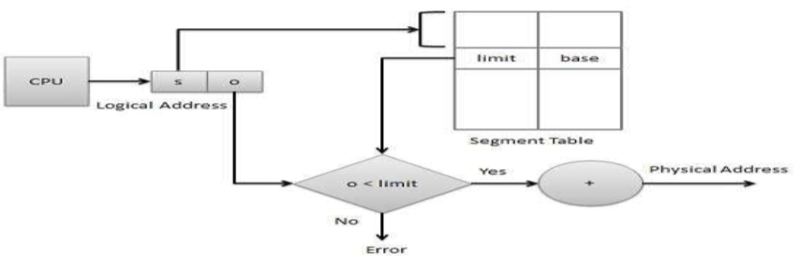
Cont….

Slide 44
Demand Paging
When a process is to be swapped in, the pager guesses which pages will be used before the process is swapped out again Instead of swapping in a whole process, the pager brings only those necessary pages into memory.
Thus, it avoids reading into memory pages that will not be used in anyway, decreasing the swap time and the amount of physical memory needed.
Hardware support is required to distinguish between those pages that are in memory and those pages that are on the disk using the valid-invalid bit scheme.

Slide 45
VIRTUAL MEMORY
Virtual memory is a technique that allows the execution of process that may not be completely in memory.
The main visible advantage of this scheme is that programs can be larger than physical memory.
Virtual memory is the separation of user logical memory from physical memory
this separation allows an extremely large virtual memory to be provided for programmers when only a smaller physical memory is available.

Slide 46
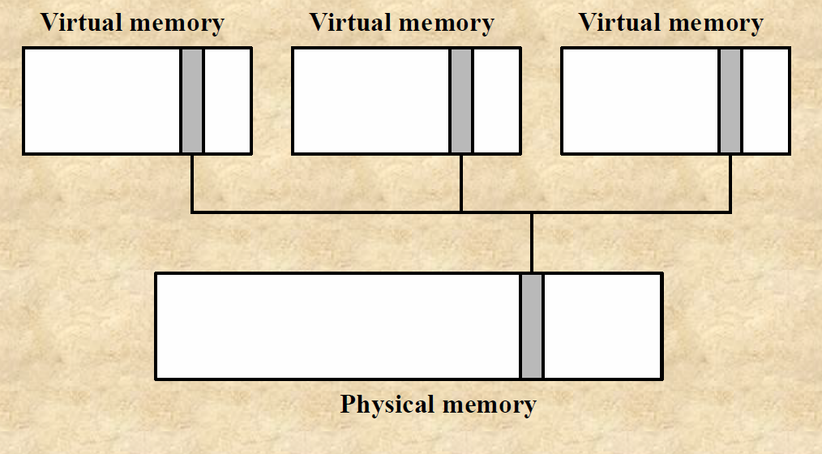
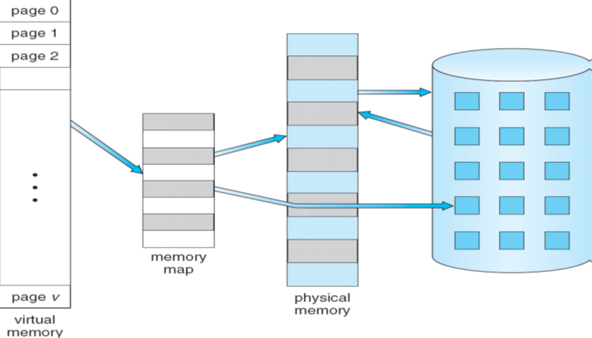
Cont…

Slide 47
Thrashing
is a condition or state in the system into which all the time a process spends is dedicated for swapping pages; thus, no computation is carried out by the process.
When pages are exchanged in and out of main memory too frequently for a process, slowing down its execution, this condition is called thrashing.
If the number of frames allocated is too low, the execution of the process will generate an excessive number of page faults, and eventually the process will make no progress in its execution because it will spend practically all of its time paging-that is, swapping pages in and out.

Slide 48
One approach used to prevent thrashing is to determine or estimate, for every active process, the sizes of the localities of the process in order to decide on the appropriate number of frames to allocate to that process.
The performance of the system is affected by thrashing.
The CPU utilization and throughput decrease at a very fast rate when thrashing occurs.
Thrashing of one process may cause other processes to thrash, if the operating system uses a global allocation strategy.
This allocation strategy provides a global pool of frames for processes to select a replacement frame when needed.

Slide 49
The Working Set Algorithm
It estimates the number of frames needed by a process in its next execution phase based on its current memory requirements.
The working set model finds out the number of unique pages in a locality, and maintains those many frames for the process.
Hence all the required pages can be in the main memory for a certain locality.
This prevents thrashing and reduces page faults.
The quantity of WSW is called the working set window.
Based on the size of the working set, more frames can be allocated or deallocated to or from the process.
The total number of pages that should be allocated to a process is the size of its working set.

Slide 50
Caching
The most common technique used to reduce disk accesses is the block cache or buffer cache.
(Cache is pronounced ‘‘cash’’ and is derived from the French cacher, meaning to hide.)
In this context, a cache is a collection of blocks that logically belong on the disk but are being kept in memory for performance reasons.
Various algorithms can be used to manage the cache, but a common one is to check all read requests to see if the needed block is in the cache.
If it is, the read request can be satisfied without a disk access.
The usual way is to hash the device and disk address and look up the result in a hash table.
All the blocks with the same hash value are chained together on a linked list so the collision chain can be followed.

Slide 51


